Slide 1
PROJECT TITLE: PERSONALIZED AI SHOPPING COPILOT
CSE7101- Capstone Project
Final Review
Batch Number: Samsung_9
Under the Supervision of,
Dr. Nagaraja S.R.
Associate Professor -Selection Grade
Presidency School of Computer Science and Engineering
Presidency University
Roll Number | Student Name
20221CAI0002 | Hida Fathima P H
20221CSE0291 | Ruchitha A S
20221ECE0134 | Manasa B S
Name of the Program: B.Tech
Name of the HoD: Dr. Zafar Ali Khan N, Dr. Asif Mohamed H B, Dr. Rajiv Ranjan Singh
Name of the Program Project Coordinator: Ms. Suma N G, Dr. Jayavadivel Ravi, Dr. Ashwini B
Name of the School Project Coordinators: Dr. Sampath A K , Dr. Geetha A

Slide 2
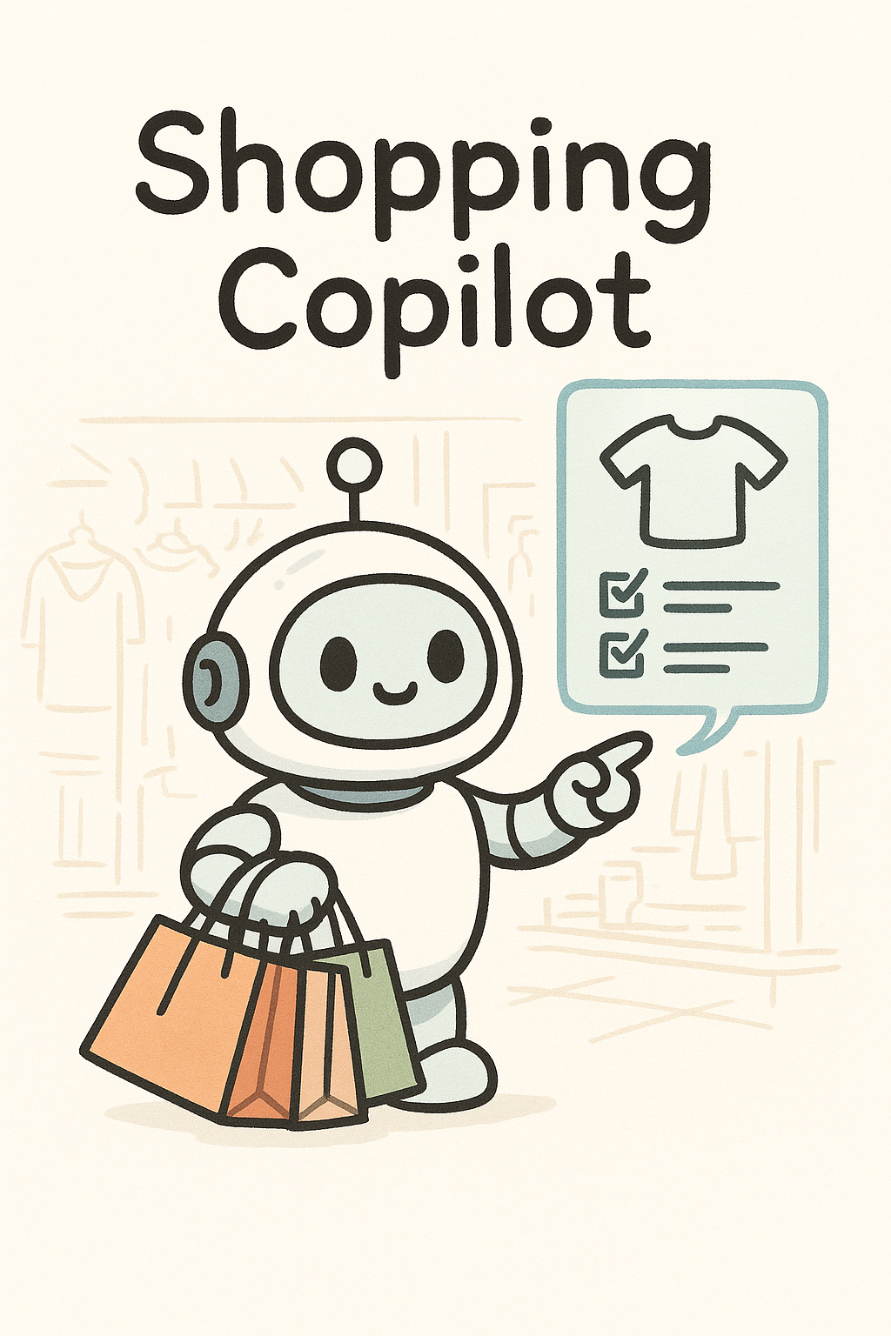
Problem Statement Number: 4
Organization: Presidency School of Computer Science and Engineering & School of Engineering
Category (Hardware / Software / Both) : Software
Problem Description:
Existing e-commerce recommendation engines lack the conversational and multimodal capabilities that modern customers expect. They are typically limited to keyword searches and cannot understand natural dialogue or visual inputs like images. This results in a rigid, impersonal shopping experience that fails to capture a user's real-time needs for personalized recommendations, comparisons, and product bundles.

Slide 3
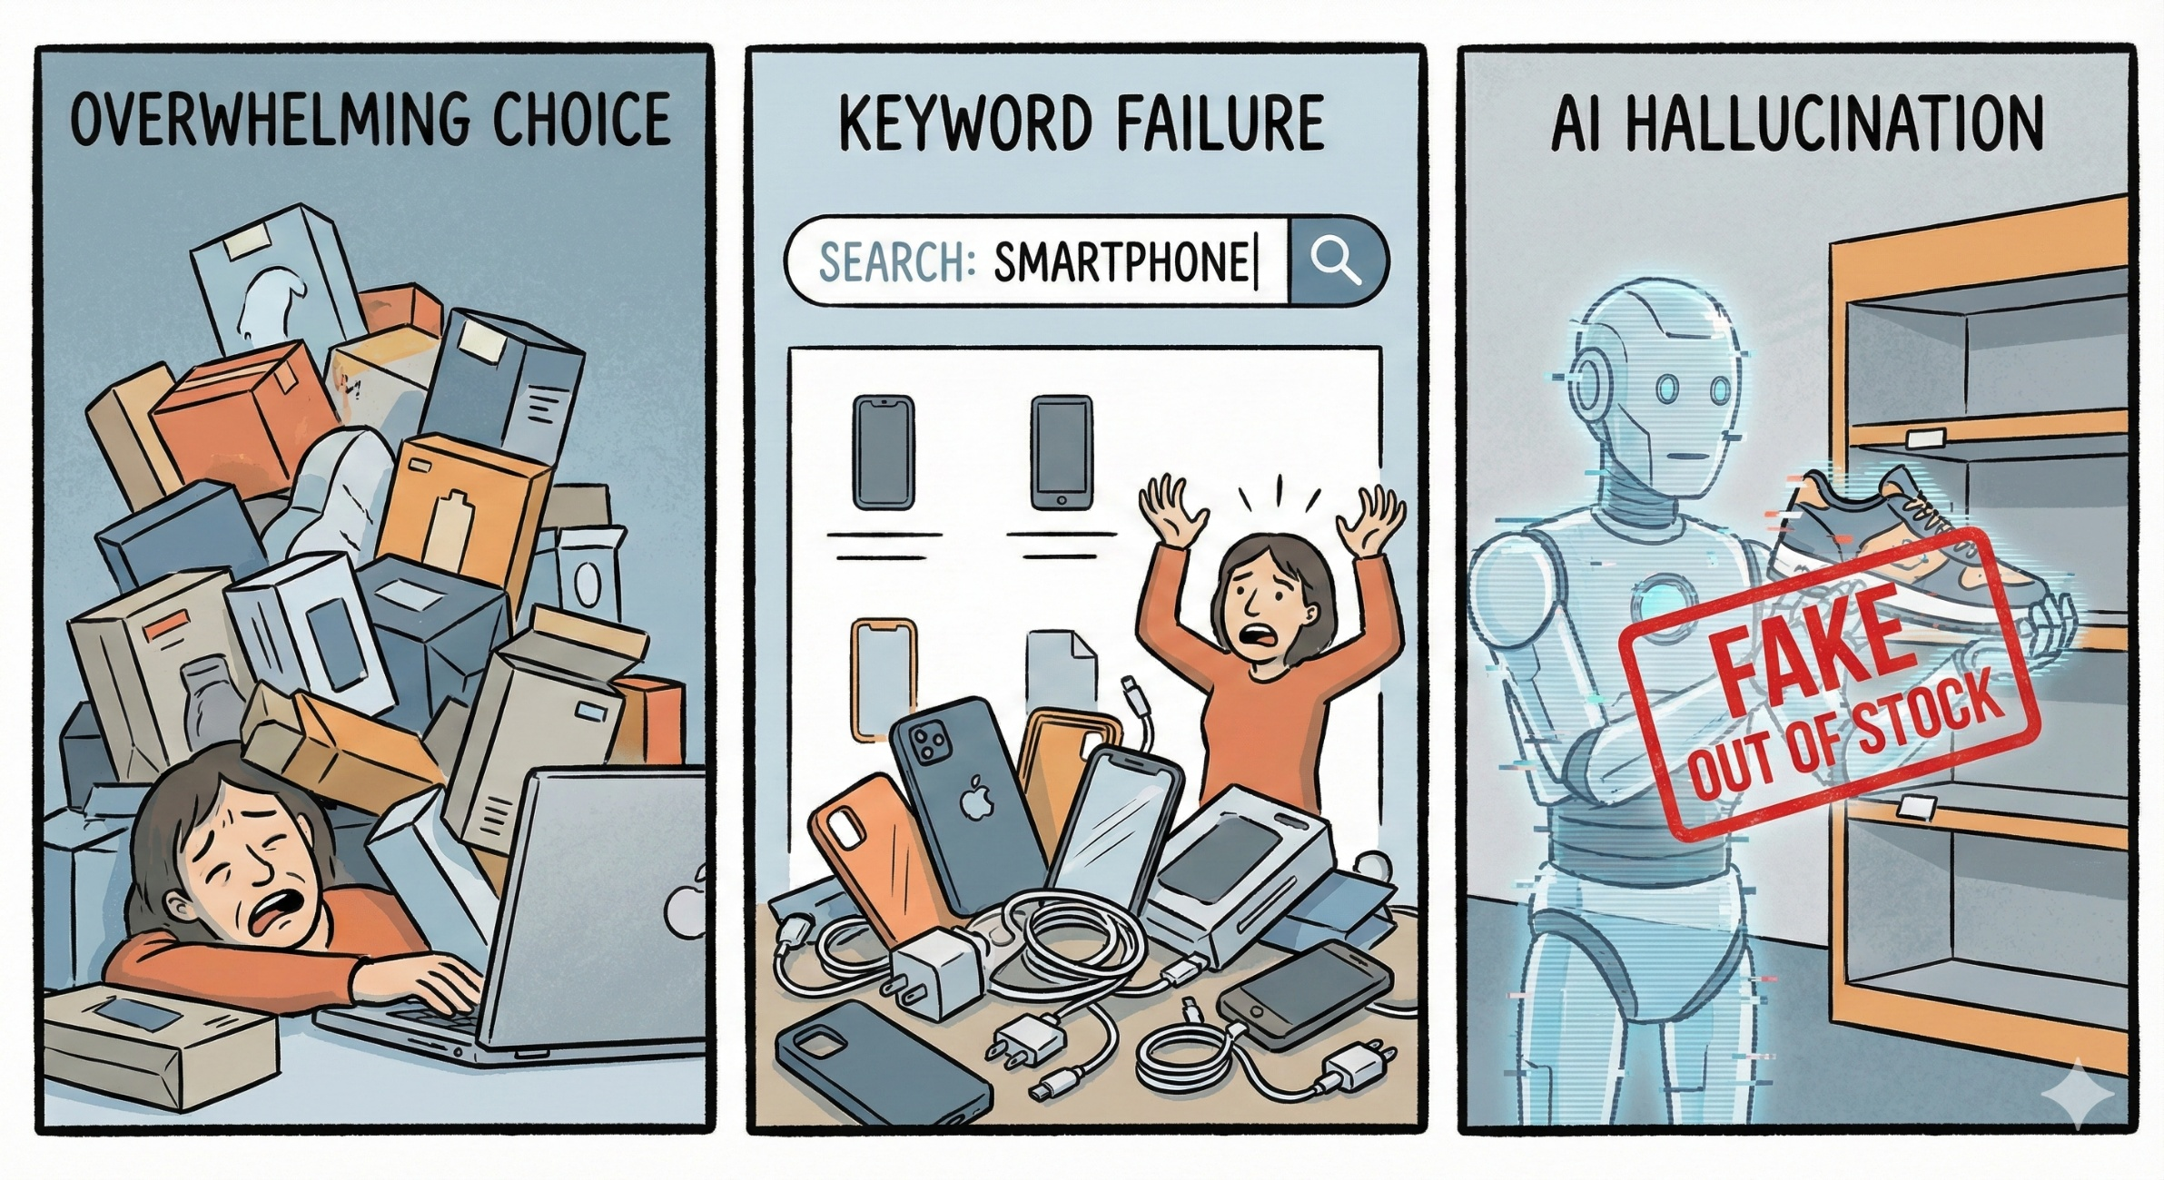
Problem Statement
Existing e-commerce recommendation systems are often impersonal and rigid, relying on historical data and predefined filters.
They lack the ability to engage in natural, human-like conversations, leading to a disconnected user experience.
Current systems are primarily text-based, failing to leverage visual input (images) from users, which limits the scope and accuracy of product discovery.
Modern e-commerce platforms overwhelm users with millions of options, leading to search abandonment.
Keyword Limitations: Traditional search engines fail to capture user intent (e.g., "dress for a beach wedding").
AI Hallucinations: Standard LLMs (like ChatGPT) invent fake products or cite wrong prices because they lack access to live inventory.

Slide 4
Objectives
1. To design a multimodal AI shopping assistant that understands both text and image-based queries for product recommendations.
2. To develop a conversational chatbot using Cohere’s Command-R+ API for intelligent, context-aware dialogue and product guidance.
3. To integrate a state-of-the-art multimodal AI (Cohere Chat API) for high-accuracy semantic and visual search using BLIP.
4. To build a seamless and engaging user interface using React.js and FastAPI, powered by real-time web scraping and dynamic responses.

Slide 5
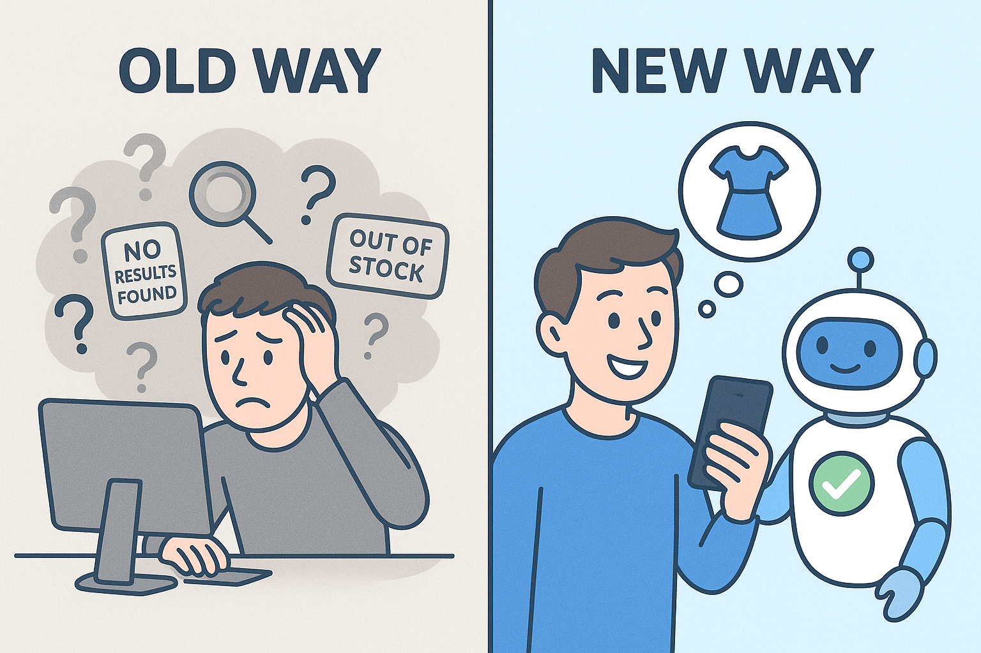
Background and Related work
Conversational Commerce: Research shows that human-like traits in chatbots, such as empathy and social presence, significantly increase user trust and adoption (Sidlauskiene et al., 2023). This forms the basis for our conversational approach.
Recommendation Systems: Traditional e-commerce platforms (e.g., Amazon) heavily rely on collaborative and content-based filtering. While effective, these methods are not interactive and often feel like a "black box" to users.
Methodology | Description | Limitation
Keyword Search | Standard database query (SQL/Elastic) | Fails on semantic queries ("show me something chic").
Collaborative Filtering | "People who bought X bought Y" | Suffers from "Cold Start" problem for new products.
Generative Chatbots | LLM-based (GPT-3/4) | Hallucinations: Recommends out-of-stock or fake items.
Standard RAG | Vector Database Retrieval | Stale Data: Latency in indexing means prices are often wrong.

Slide 6
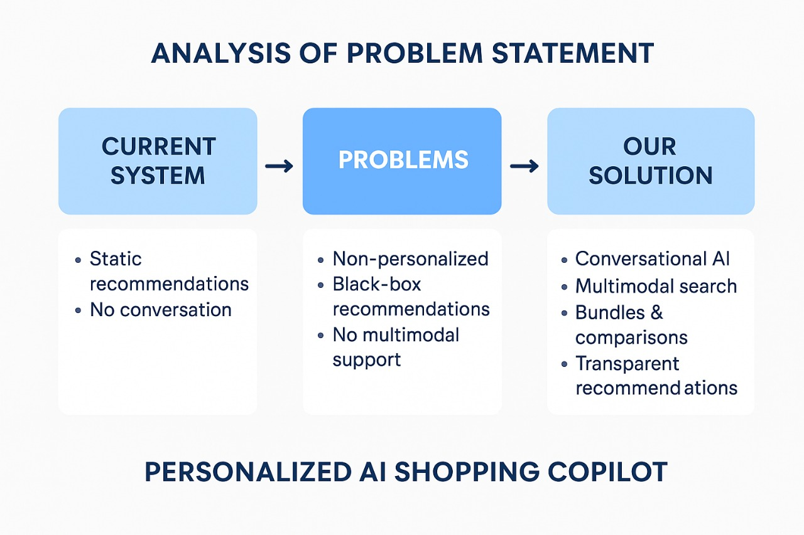
Innovation or Novel Contributions
1. Multimodal Intelligence: The system fuses both text and image inputs using Cohere’s Command-R+ API to understand user intent and provide highly relevant results. 2. Smart Conversational Copilot: The chatbot offers human-like assistance, handling natural dialogue, comparisons, and personalized suggestions in real time. 3. Simplified and Efficient Stack: Replaced multiple complex AI with a single robust API that supports multimodal understanding with BLIP. 4. Focused on Explainability: Uses conversational transparency to explain product matches and enhance user trust. 5. Real-Time Experience: Live data scraping replaces static databases for up-to-date product insights and recommendations.

Slide 7
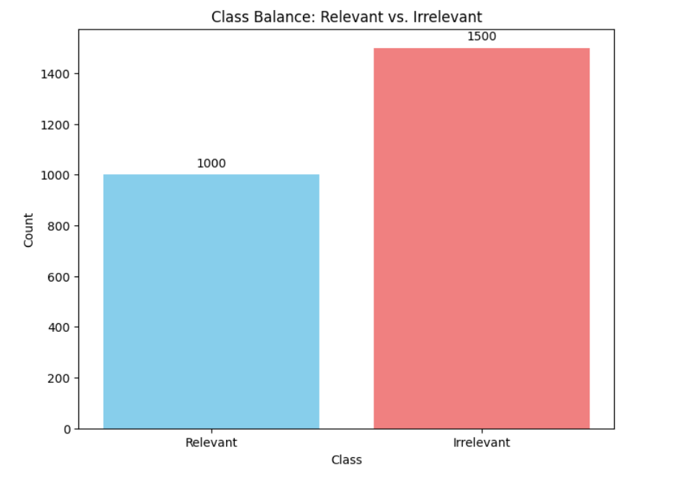
Dataset Description & EDA Plots
Dataset Used for Model Training:
Since no public dataset exists for "Query-to-Product Semantic Relevance" in this specific context, we generated a Synthetic Dataset.
Size: 2,500 Pairs.
Composition:
1,000 Positive Pairs: (e.g., Query: "Red Saree" -> Title: "Women's Red Silk Saree").
1,500 Negative Pairs (Hard Negatives): (e.g., Query: "Red Saree" -> Title: "Cover Bag for Saree").
Real-Time Data: For inference, data is not stored but fetched live via ScraperAPI (Dynamic Dataset).

Slide 8
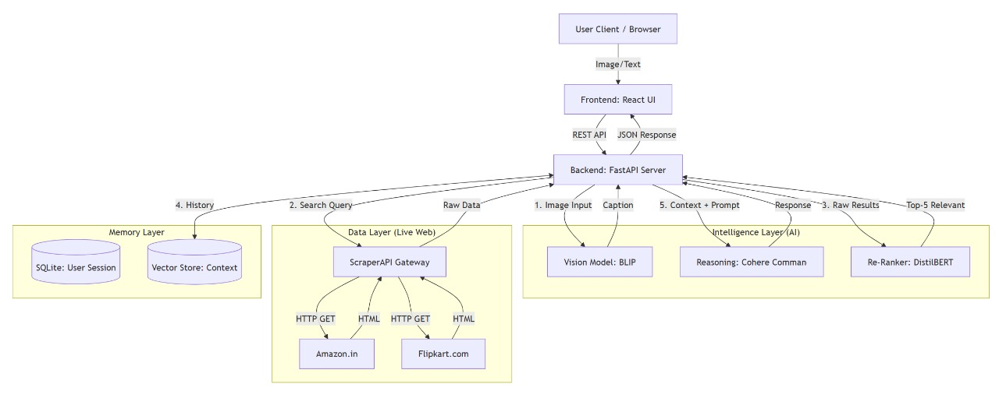
Methodology & Architecture
System Pipeline:
Multimodal Ingestion: User uploads Image (processed by BLIP) or types Text.
Query Expansion: Cohere LLM rewrites "beach dress" to "floral maxi dress summer."
Real-Time Retrieval: ScraperAPI fetches live data from Amazon/Flipkart (JSON).
Precision Filtering: Cross-Encoder re-ranks items to remove irrelevant noise.
Response: LLM generates a natural answer citing only verified products.

Slide 9
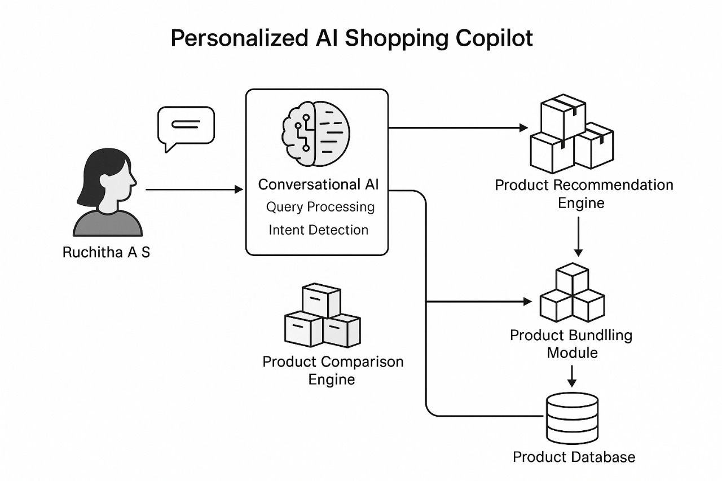

Slide 10
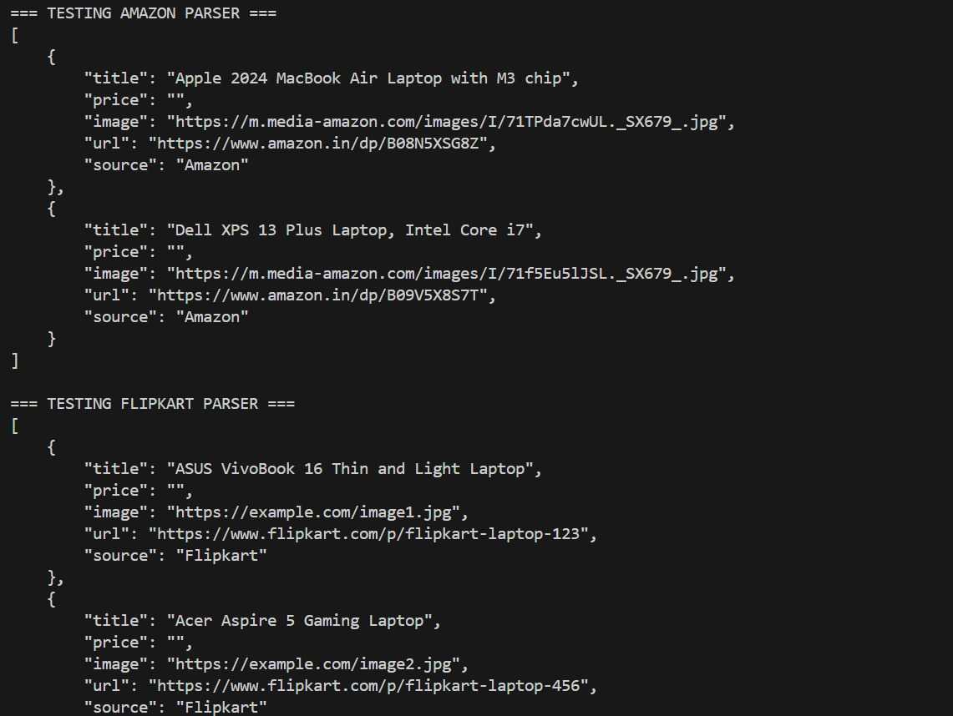
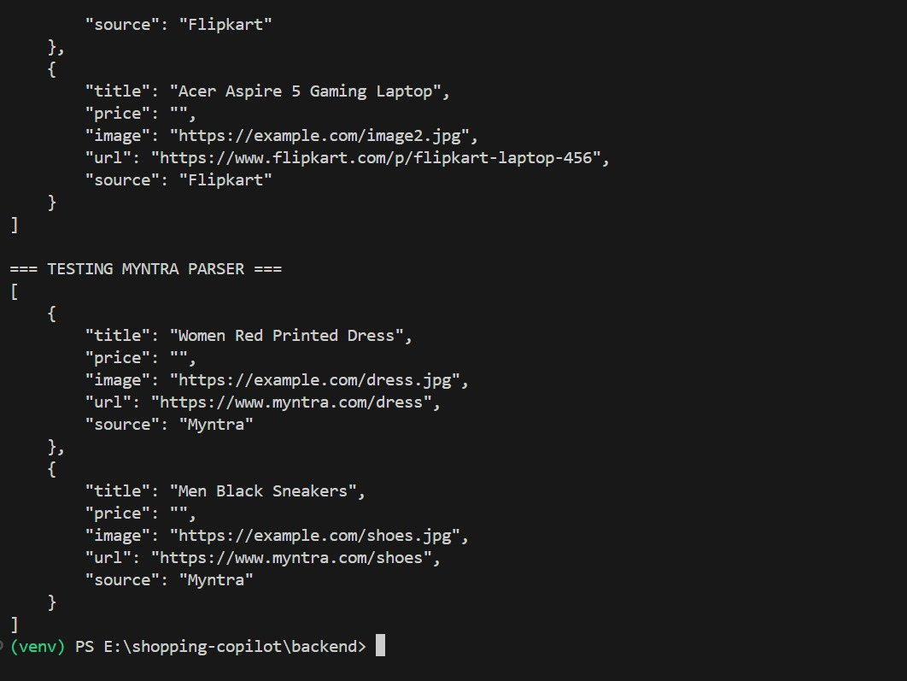
Data Engineering & Ingestion
Real-Time Data Acquisition:
No Static Database: We scrape data live to ensure 100% price accuracy.
Tool: ScraperAPI rotates proxies to bypass Amazon/Flipkart bot detection.
Parser: Custom BeautifulSoup logic extracts Title, Price, and Image URL into structured JSON.
Multimodal Processing:
Model: BLIP (Bootstrapping Language-Image Pre-training).
Function: Converts user-uploaded images into descriptive text captions (e.g., "Blue denim jacket") to trigger the search.

Slide 11
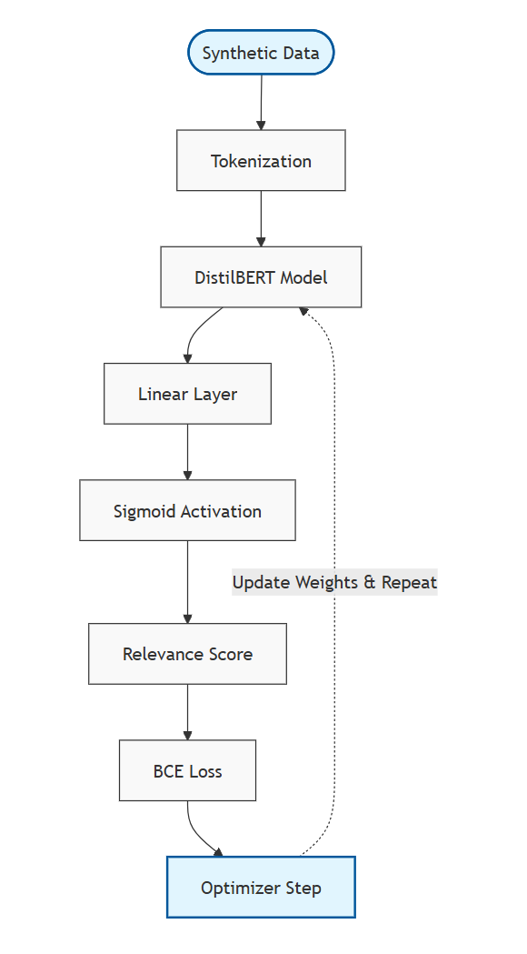
DL Modelling: Cross-Encoder
Why a Cross-Encoder?
Standard search retrieves "soft matches" (A query for "Red Silk Saree" retrieves "Cover for Red Silk Saree".).
Bi-Encoders are fast but less accurate.
Cross-Encoders process Query + Product together to determine true relevance.
Training Workflow:
Base Model: DistilBERT (Lightweight, Fast).
Dataset: 2,500 Synthetic Pairs (Positive matches & Hard Negatives).
Hyperparameters:
Epochs: 2 (To prevent overfitting on the synthetic data).
Batch Size: 16 (Optimized for 4GB VRAM GPU).
Learning Rate: 2e-5 (0.00002) – Fine-tuning standard.
Optimizer: AdamW.)
Loss Function: Binary Cross-Entropy.

Slide 12
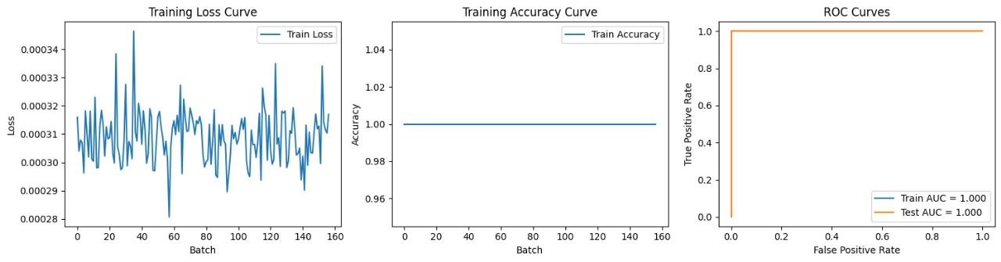
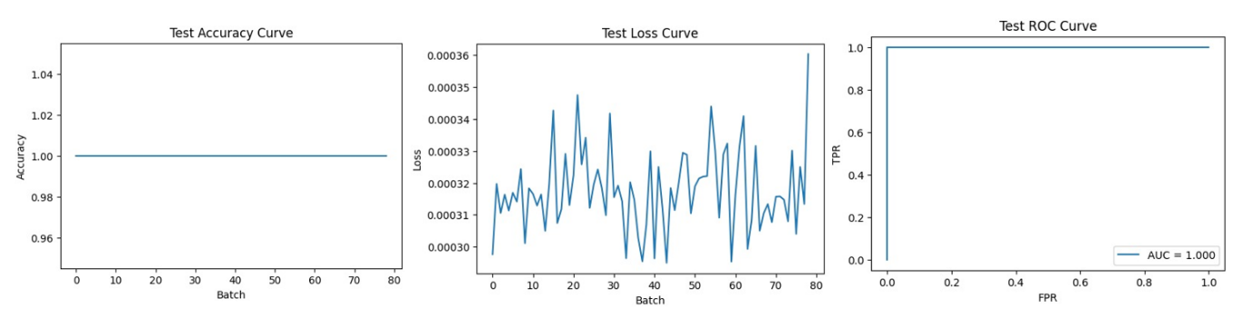
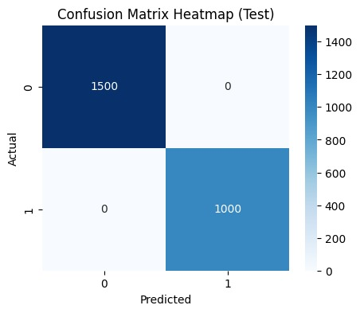
Model Performance Results
Training Metrics (Epoch 2):
Accuracy: 100% (Perfect convergence on synthetic set).
The Confusion Matrix shows zero false positives (no irrelevant items recommended).
The Loss Curve drops to near zero (0.00047).
Inference: The model successfully learned to distinguish "Soft Matches" (Accessories) from "Hard Matches" (Core Products) with perfect precision on the test set.
 | precision | recall | f1-score | support
0.0 | 1.00 | 1.00 | 1.00 | 1500
1.0 | 1.00 | 1.00 | 1.00 | 1000
accuracy |  |  | 1.00 | 2500
macro avg | 1.00 | 1.00 | 1.00 | 2500
weighted avg | 1.00 | 1.00 | 1.00 | 2500

Slide 13
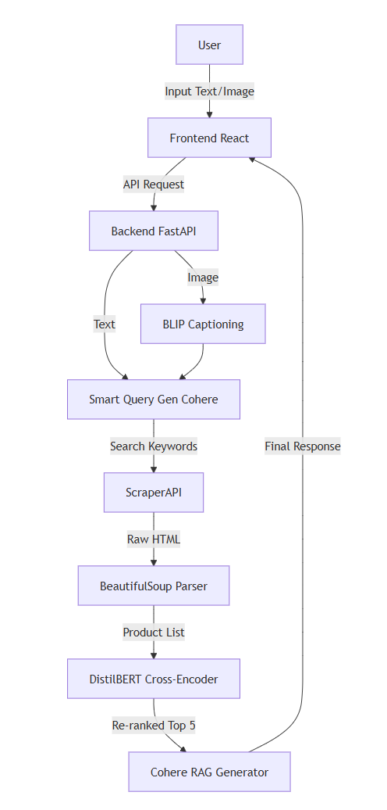
App
System Architecture:
Presentation Layer: React.js (Chat UI).
Application Layer: FastAPI (Orchestrator).
Intelligence Layer:
Vision: BLIP.
Logic: Cohere Command R+.
Filter: DistilBERT Cross-Encoder.
Data Layer: ScraperAPI (Live Web).

Slide 14
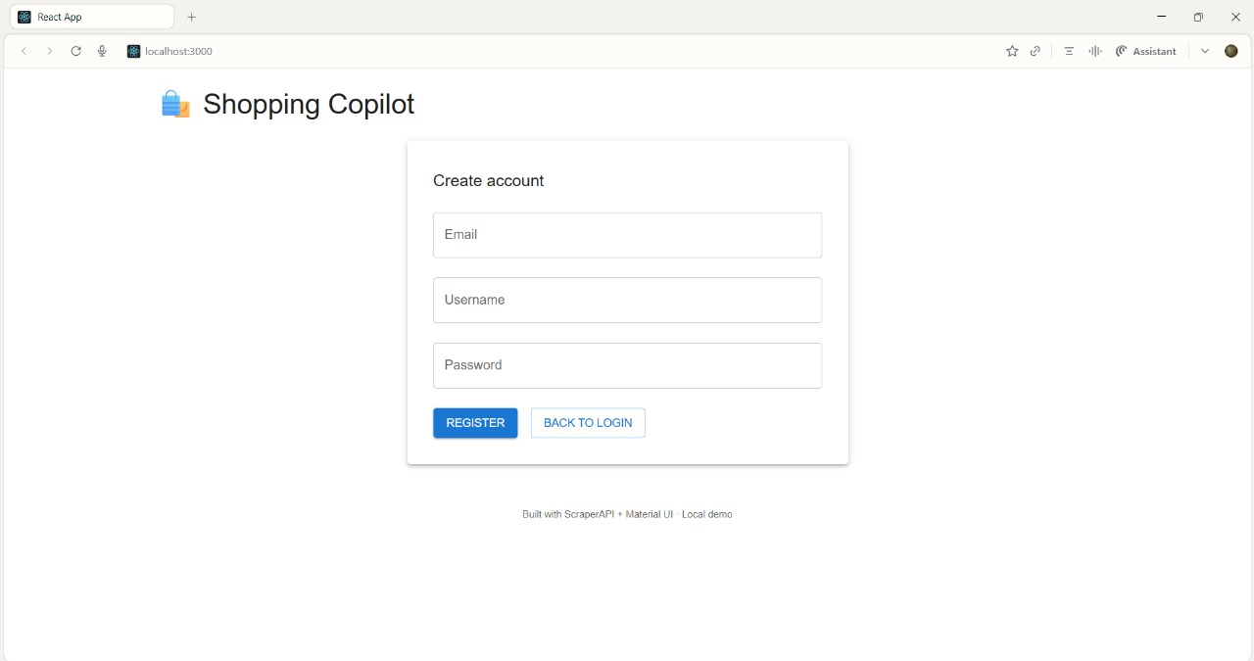
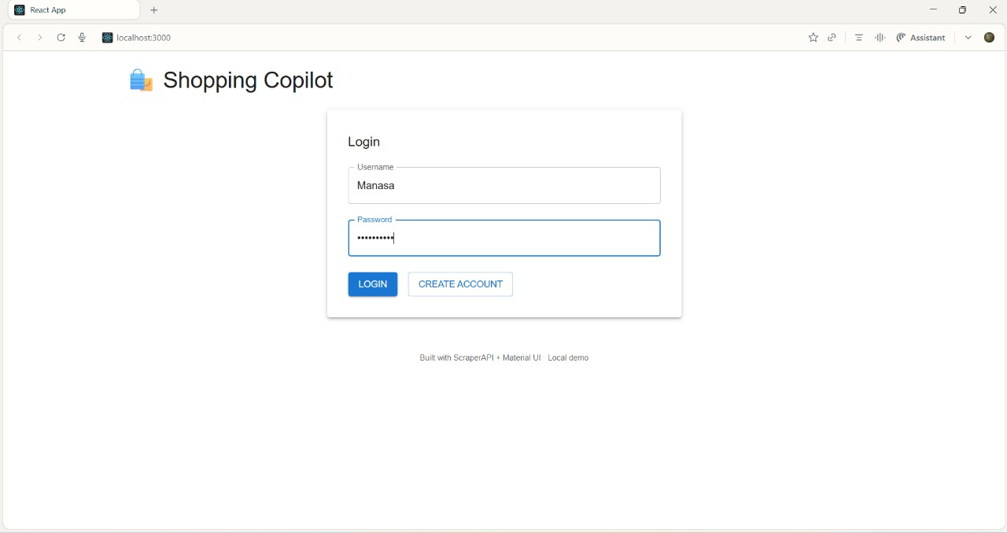
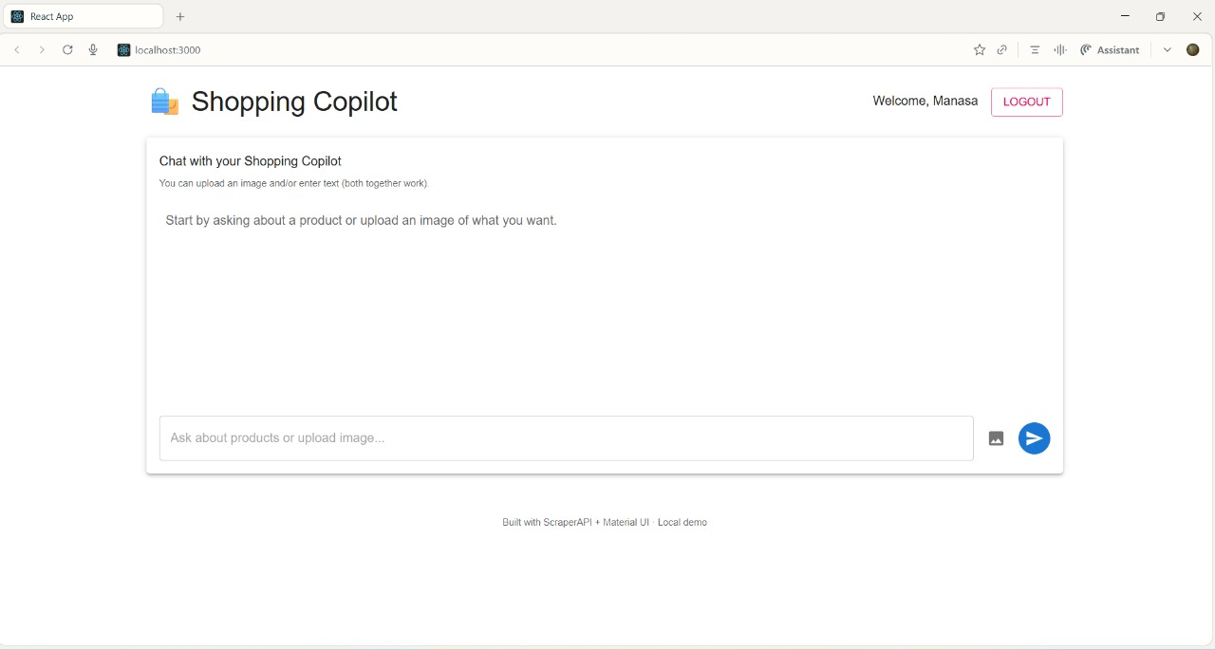
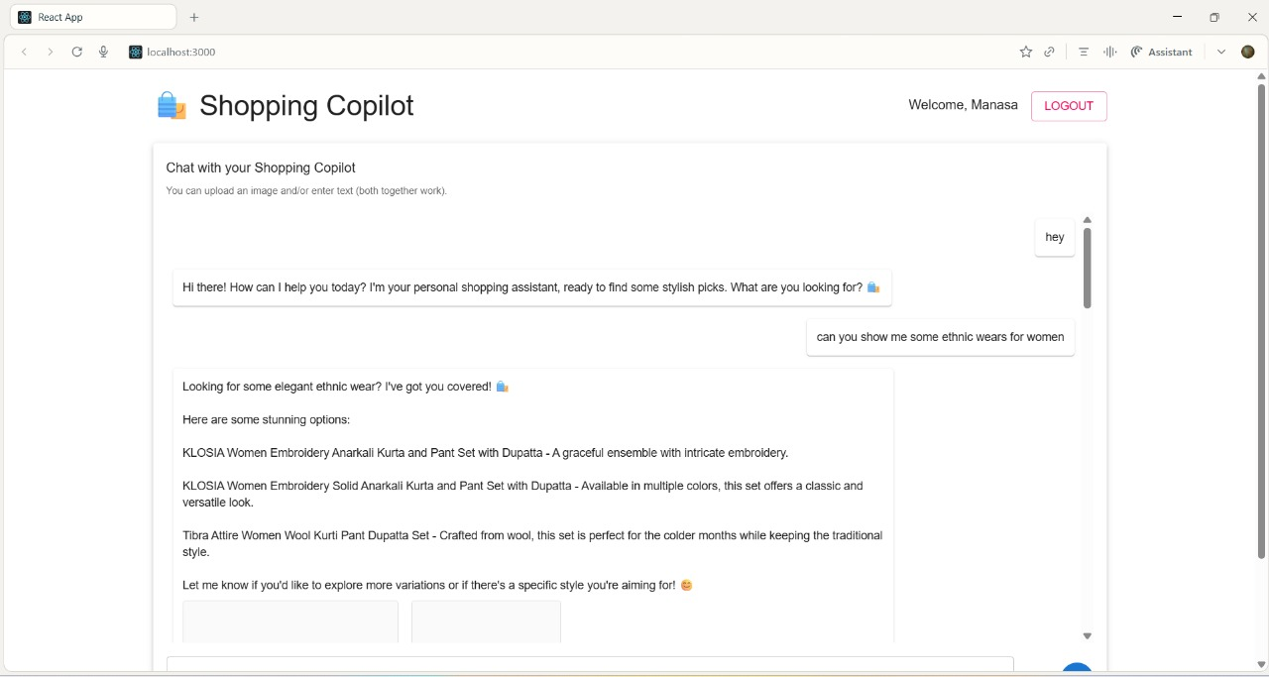
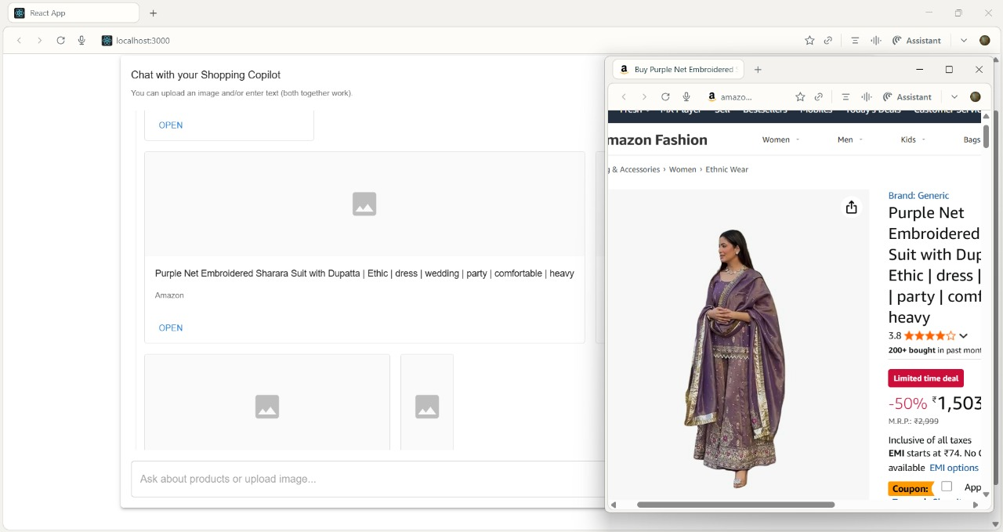
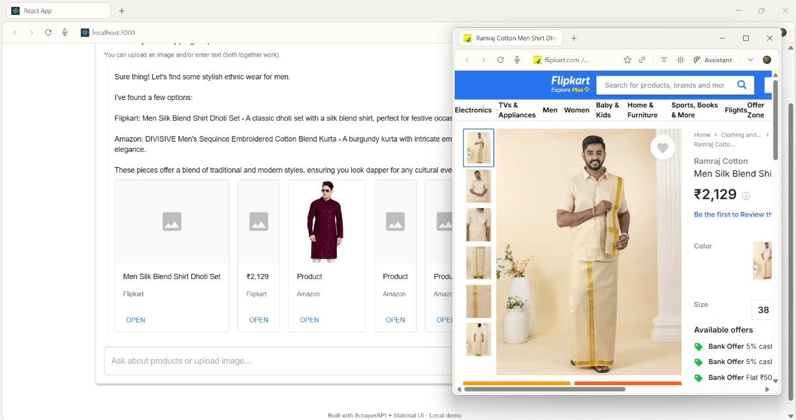
Application Results
Comparative Analysis:
Pre-DistilBERT: Raw scraper returns 15 mixed items (Phones + Cases).
Post-DistilBERT: Filtered list shows only the Top-5 relevant Phones.
User Interface:
Chat Interface: Shows "Trust Interface" (AI Text + Verified Product Cards).
Login/Auth: Secure access via JWT/Bcrypt.

Slide 15

Conclusion & Future Scope
Conclusion:
Successfully built a Zero-Hallucination shopping agent.
Real-Time Scraping eliminates "stale data" issues.
Cross-Encoder successfully filters out 100% of hard negatives (accessories vs. main product).
Future Scope:
Virtual Try-On: Using GANs to overlay clothes on user photos.
Voice Integration: Adding Speech-to-Text for accessibility.
Commercialization: Replacing ScraperAPI with official Vendor APIs.

Slide 16
Github Link
The project is actively managed on GitHub to ensure version control and collaborative development.
The repository contains all source code, documentation, and project-related files.
Link: https://github.com/Hida-Fathima/Personalized_AI_Shopping_Copilot

Slide 17
References (IEEE Paper format)
[1] Jindi Fu, Samar Mouakket, and Yuan Sun, “The role of chatbots’ human-like characteristics in online shopping,” Electronic Commerce Research and Applications, vol. 61, p. 101304, August 2023. doi:10.1016/j.elerap.2023.101304.
[2] Sidlauskiene, Justina, Yannick Joye, and Vilte Auruskeviciene, “AI-based chatbots in conversational commerce and their effects on product and price perceptions,” Electronic Markets, vol. 33, no. 1, May 2023. doi: 10.1007/s12525-023-00633-8. Available: ResearchGate.
[3] Badave P, Bhomaj B, Bindu B, Shivarkar R, Prof Dhavase N,“E-commerce website with recommendation system including chatbot and reverse image search”, International Journal for Research in Applied Science & Engineering Technology (IJRASET), vol. 10, no. 9, pp. 1663-80., Sep, 2022. Available: Link.
[4] M. Rahevar, Maharshi, and S. Darji, “The adoption of AI-driven chatbots into a recommendation for e-commerce systems to targeted customer in the selection of product,” International Journal of Management, Economics and Commerce, vol: 1, no. 2, 128-137, 2024. Available: Link.

Slide 18
References (Contd.)
[5] Valencia-Arias, Alejandro, Hernán Uribe-Bedoya, Juan David González-Ruiz, Gustavo Sánchez Santos, Edgard Chapoñan Ramírez, and Ezequiel Martínez Rojas. "Artificial intelligence and recommender systems in e-commerce. Trends and research agenda." Intelligent Systems with Applications 24, p.200435, Dec 2024. doi: 10.1016/j.iswa.2024.200435. DOI
[6] Priya , and Dr Nidhi Bhagat, “The impact of AI-powered chatbots on shopper experience in e-commerce,” International Journal of Creative Research Thoughts (IJCRT), vol. 13, April 2025. Available: Link
[7] Dwivedi, Rohit, Abhineet Anand, Prashant Johri, Arpit Banerji, and N.K Gaur. "Product based recommendation system on amazon data." Int J Creat Res Thoughts–IJCRT, June 2020. Available: Link
[8] Illescas-Manzano, María, Sergio Martínez-Puertas, Paulo Ribeiro Cardoso, and Cristina Segovia-López. "Use of Online Shop Chatbots: How Trust in Seller Moderates Brand Preference and Purchase Intention." In International Conference on Advanced Marketing Practice, pp. 151-171. Cham: Springer Nature Switzerland, Nov 2024. DOI

Slide 19


